Slide 1
PREDICTING STUDENTS' AVERAGE PERFORMANCE
April Meyer
DSC680-T301 Applied Data Science (2215-1)

Slide 2
Introduction and Problem Statement
Standardized testing has been included in the educational system throughout history and has caused controversy. This type of testing measures a student’s progress at any given time in their education.
One side of the debate is that this type of testing causes teaching for the test and does not allow for creativity or critical thinkers; while the other side states it is a reasonable and unbiased way to quantify student’s performance. However, there is more to this debate.
There are numerous influences that can affect how a student will perform on exams, including physical, social, and environmental. The impact could be negative, positive, or nothing. This analysis seeks to show how data could be used to understand these influences.

Slide 3
Data Source and Exploration
It is a fictional dataset used to show how machine learning could be applied in education. Link to data, http://roycekimmons.com/tools/generated_data/exams.

Slide 4
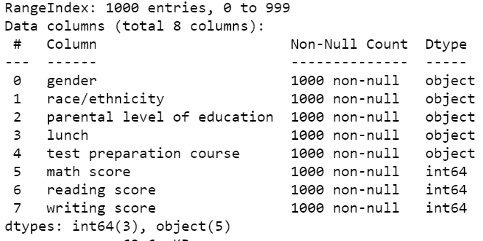
Data Attributes
gender: male or female
race/ethnicity represents five (A-E) groups
parental level of education: six levels of education
lunch: standard or free/reduced.
test preparation course: none or completed.
math score: score for math
reading score: score for reading
writing score: score for writing

Slide 5
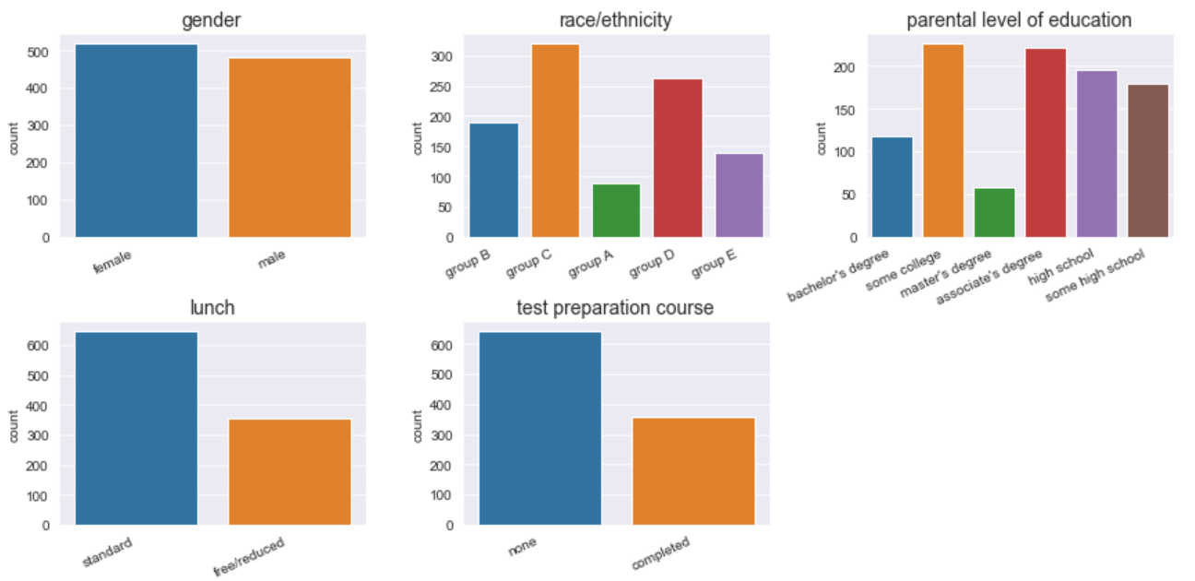
Categorical Count of All Variables

Slide 6
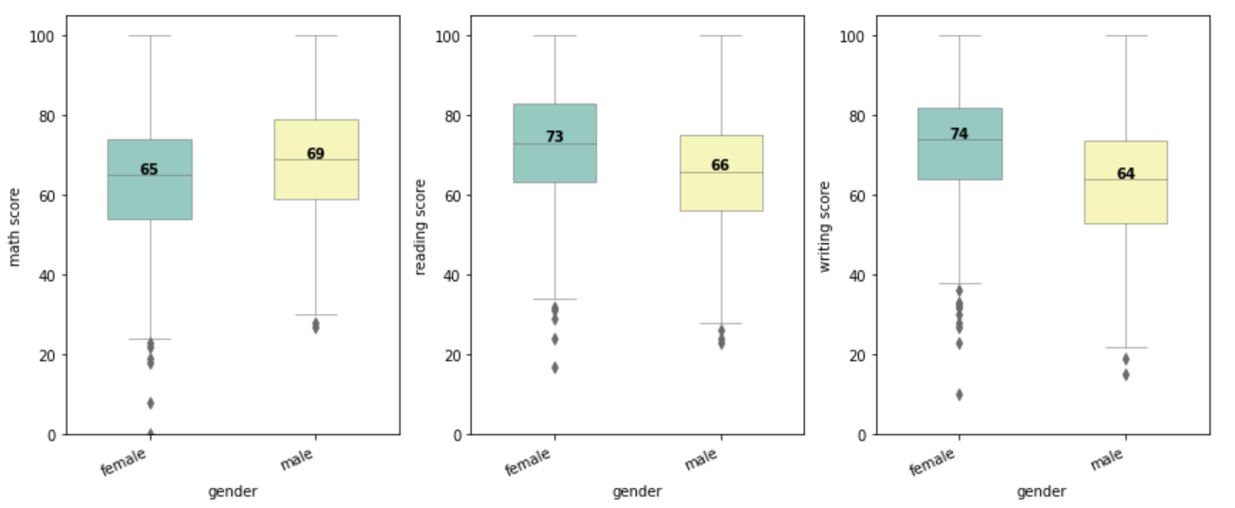
Variation of Scores by Gender of the Student

Slide 7
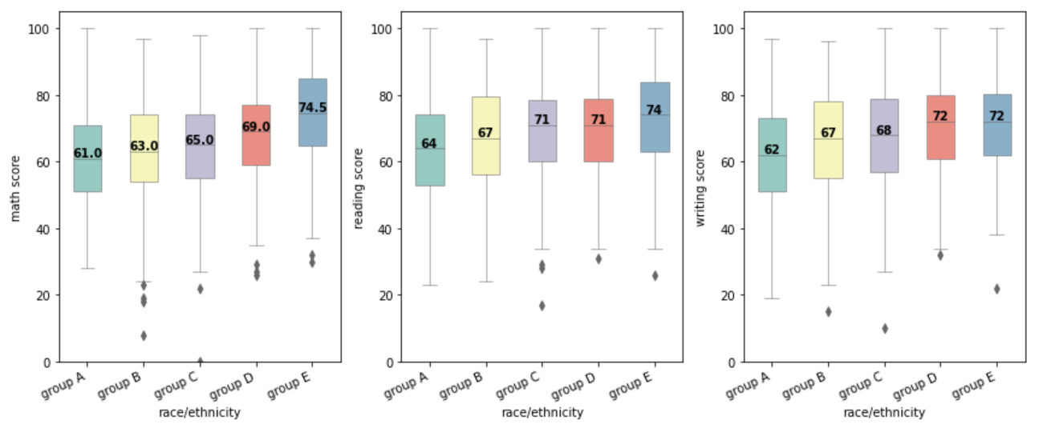
Variation of Scores by Race/Ethnicity

Slide 8
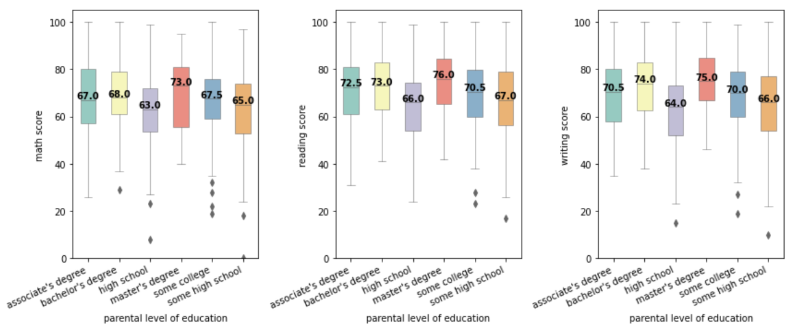
Variation of Scores by Parental Education

Slide 9
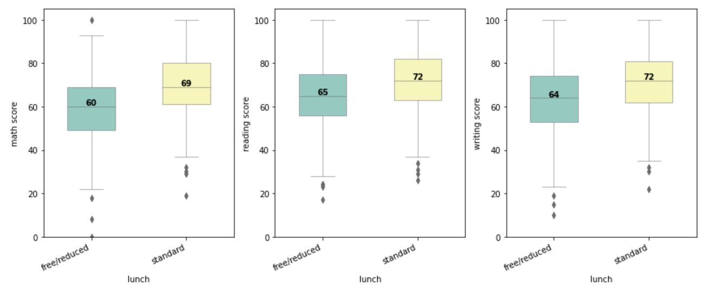
Variation of Scores by Standard/Free Lunch

Slide 10
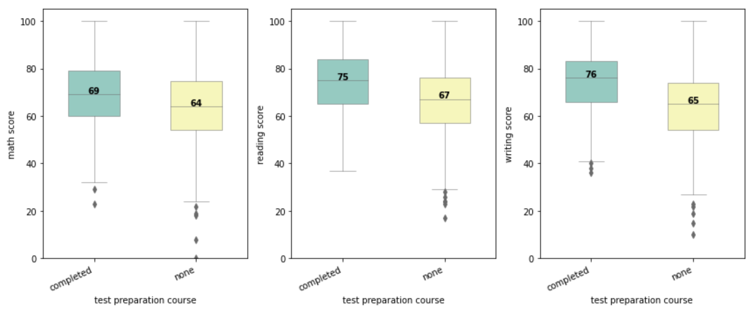
Variation of Scores by Test Preparation

Slide 11
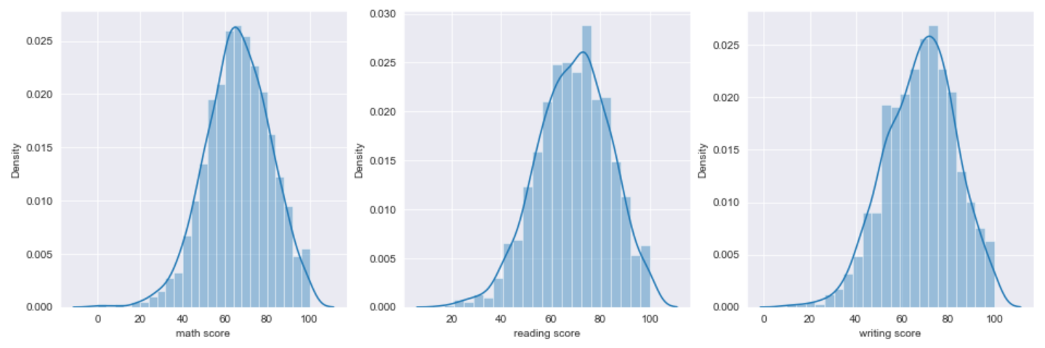
No Skewness in the Target Columns

Slide 12
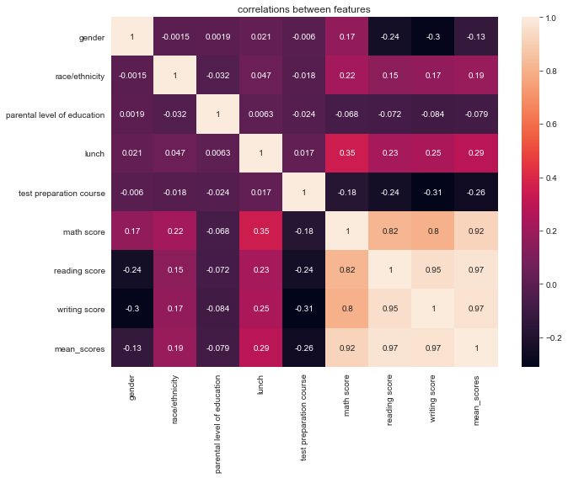
Data Preparation
Categorical features were transformed to use in model and correlations were evaluated
A new feature was created called mean_score

Slide 13
Models Used
Linear Regression
A linear model that looks at the relationship between a dependent variable and explanatory or independent variables
Random Forest Regressor
An ensemble learning method that runs by assembling a variety of decision trees at training and outputs the mean of predication of individual trees.
Supervised machine learning models were used for this project, linear regression, and random forest regressor.

Slide 14
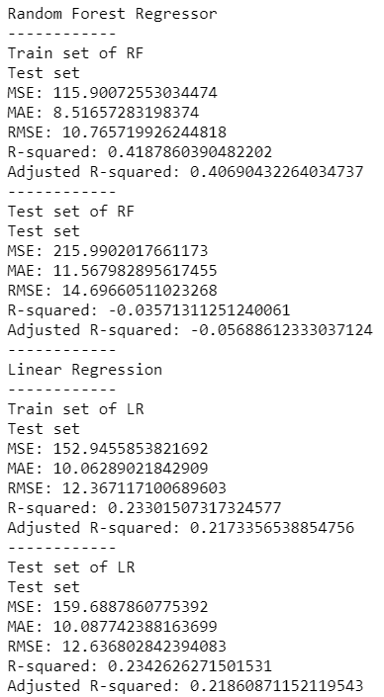
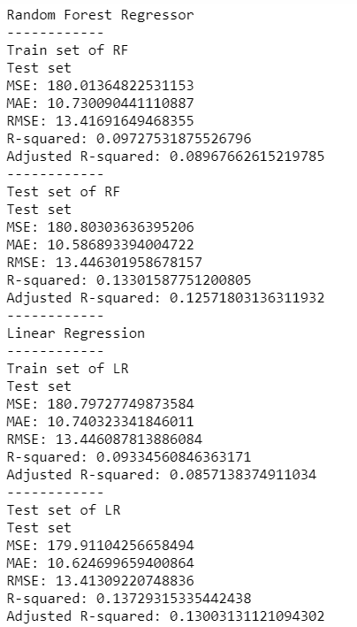
Model Results
All variables as independent variables
Lunch and Race/Ethnicity as independent variables

Slide 15
Conclusion
Overall, the two models did not perform well. It does suggest that finding variables that would impact student’s scores could be difficult. However, using a different model or real-life data could give different results. The data correlation does suggest that lunch could impact scores. Real-life data could give more variables to work with and would be worth exploring.

